Slide 1
KHATRA ADIBASI MAHAVIDYALAYA
B.A Program in Physical Education Name of the Teacher- TITHI ROY
Subject- Physical Education
Semester - III
Course Title: Yogasana and Gymnastics
Topic: Unit- I: YOGASANA
Session: 2021-22

Slide 2
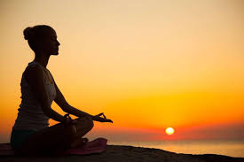
YOGA

Slide 3
PASCHIMOTTANASANA

Slide 4
Steps of Paschimottanasana
Sit on a mat with your legs stretched straight in front of you.
Toes should remain together pointing forward.
Now, Inhale, raise your arms, and bend the body forward exhaling as far as possible.
While bending forward, do exhaling.
In the final stage, interlocked fingers should be beyond the toes and the nose should touch the knees.

Slide 5
Steps of Paschimottanasana
Initially, do it for 5 seconds and gradually try to maintain the pose as long as you feel comfortable.
Inhale and come to the original position.
This is one round. Initially, do two rounds.
As per your practice, you may increase the number of rounds as well as the duration of maintaining the pose.

Slide 6
Paschimottanasana

Slide 7
How to Practice

Slide 8
Benefits of Paschimottanasana
Stretches hamstrings and gluteal muscles
Strengthen quads, abdominals, and knee joints.
Stretches calf muscles.
Builds strength in the shoulders.
Strengthens biceps, if done with bent arms, and triceps, if done with straight arms.
Helps improve flexibility of hips.

Slide 9
Benefits of Paschimottanasana

Slide 10
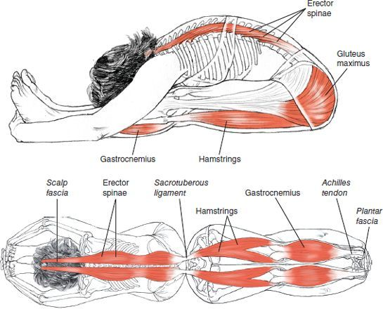
Benefits of Paschimottanasana

